Slide 1
The very hungry Caterpillar by Eric Carle

Slide 2
To my daughter on her birthday) with great love and best wishes*

Slide 3
In the light of the moon

Slide 4
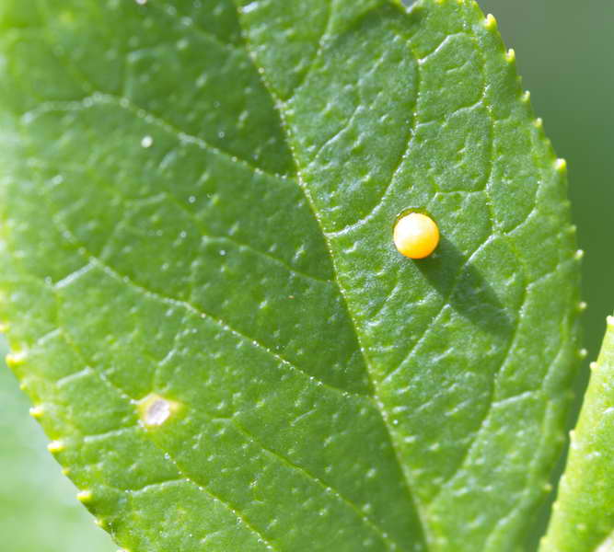
a little egg lay on a leaf.

Slide 5
One Sunday morning the warm sun came up

Slide 6
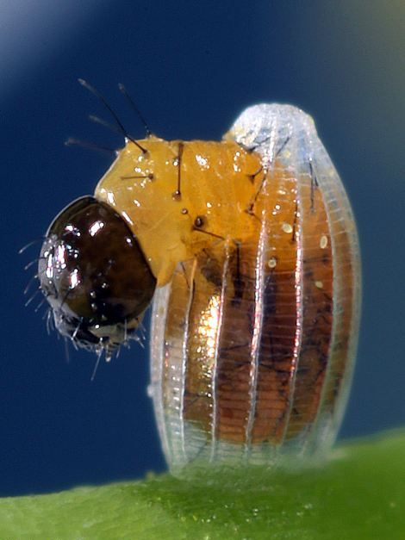
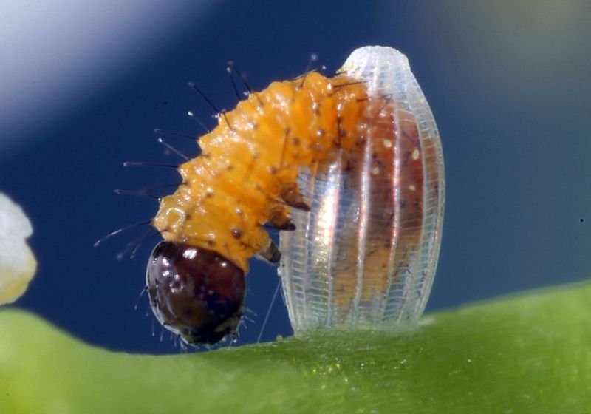
and out of the egg came a tiny and very
hungry Caterpillar.

Slide 7
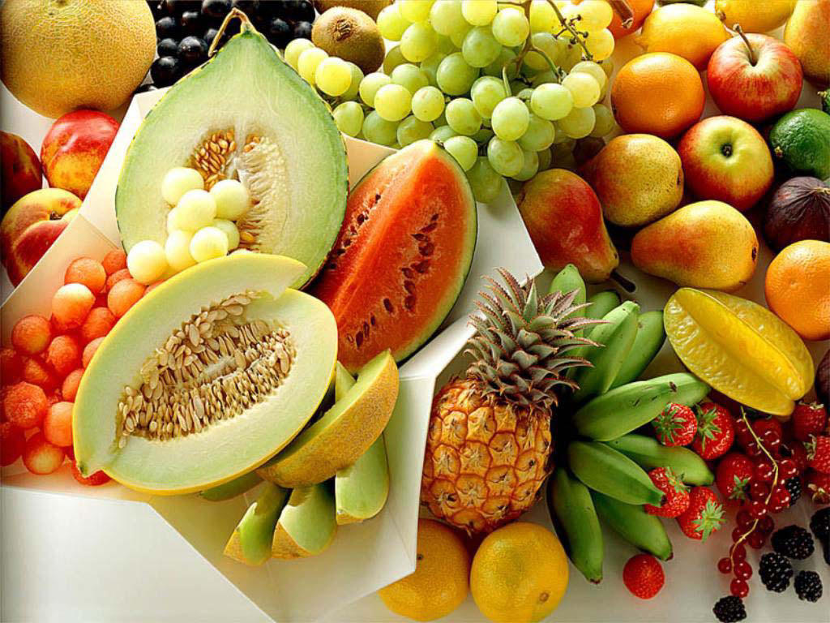
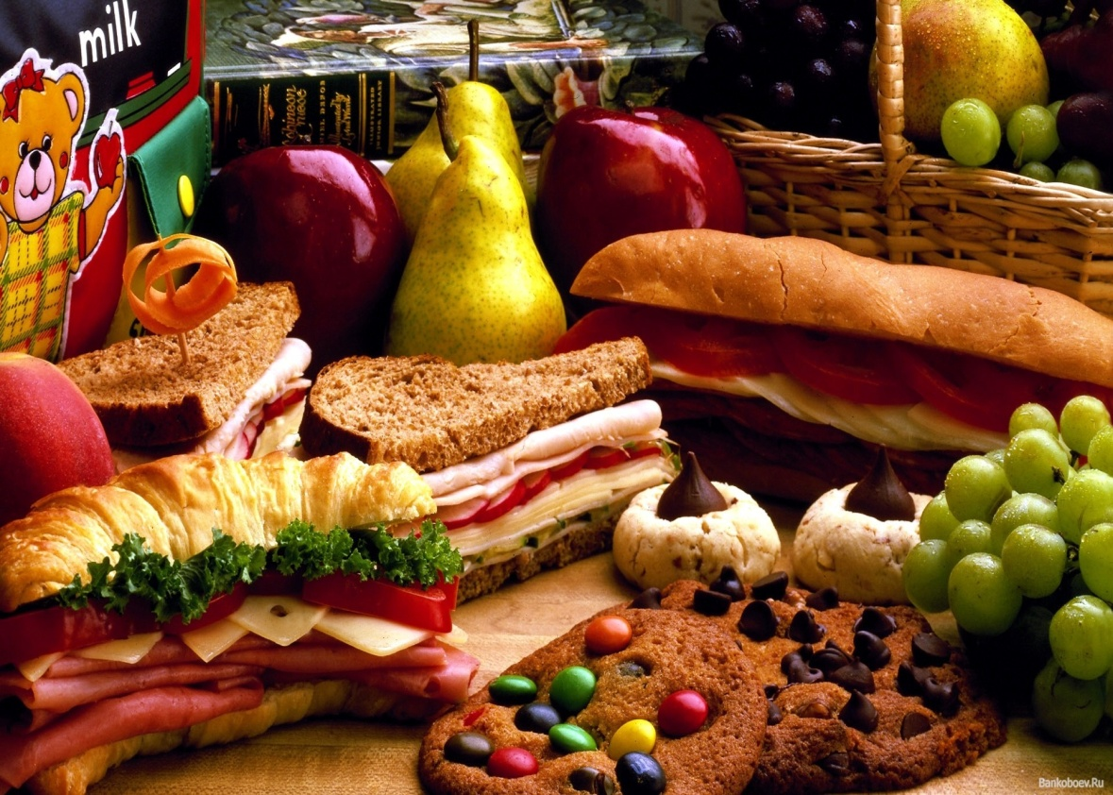
He started to look for some food.

Slide 8
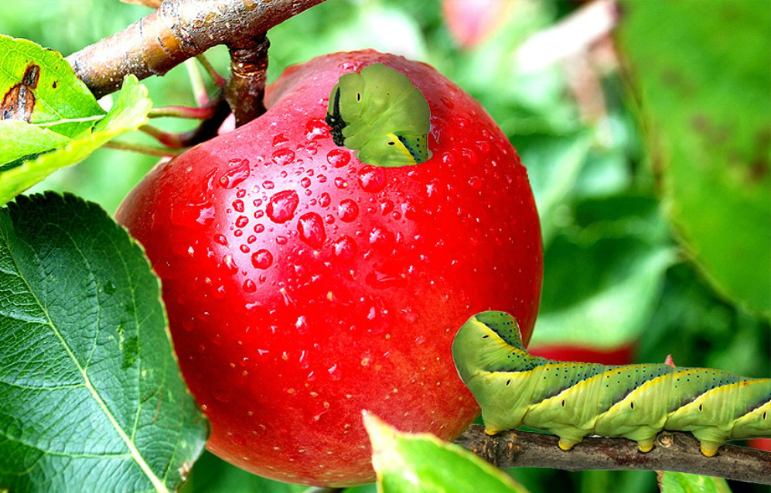
On Monday he ate through one apple

Slide 9
On Monday he ate through one apple
but he was still hungry.

Slide 10
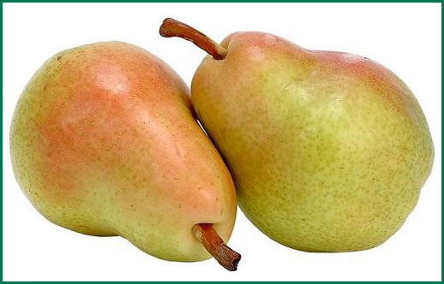
On Tuesday he ate through two pears
but he was still hungry.

Slide 11
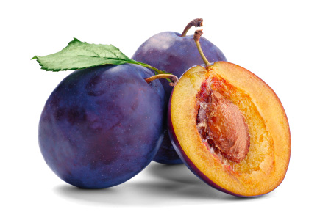
On Wednesday he ate through three plums
but he was still hungry.

Slide 12
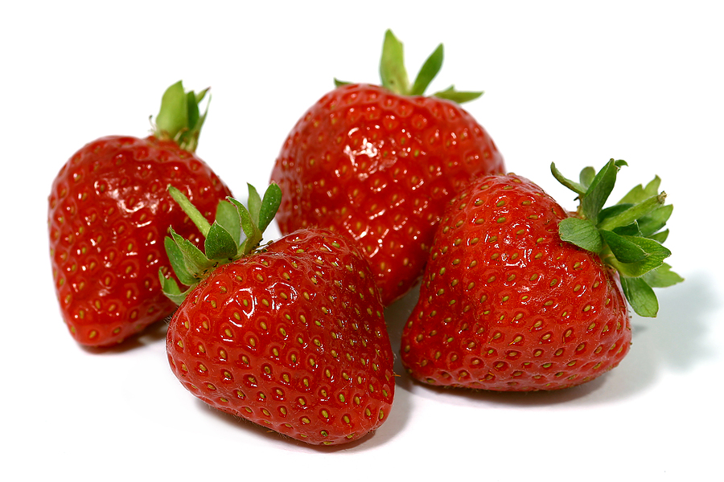
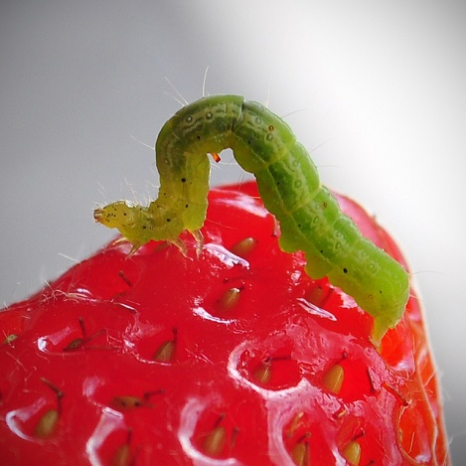
On Thursday he ate through four strawberries
but he was still hungry.

Slide 13
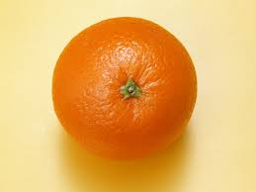
On Friday he ate through five oranges
but he was still hungry.

Slide 14
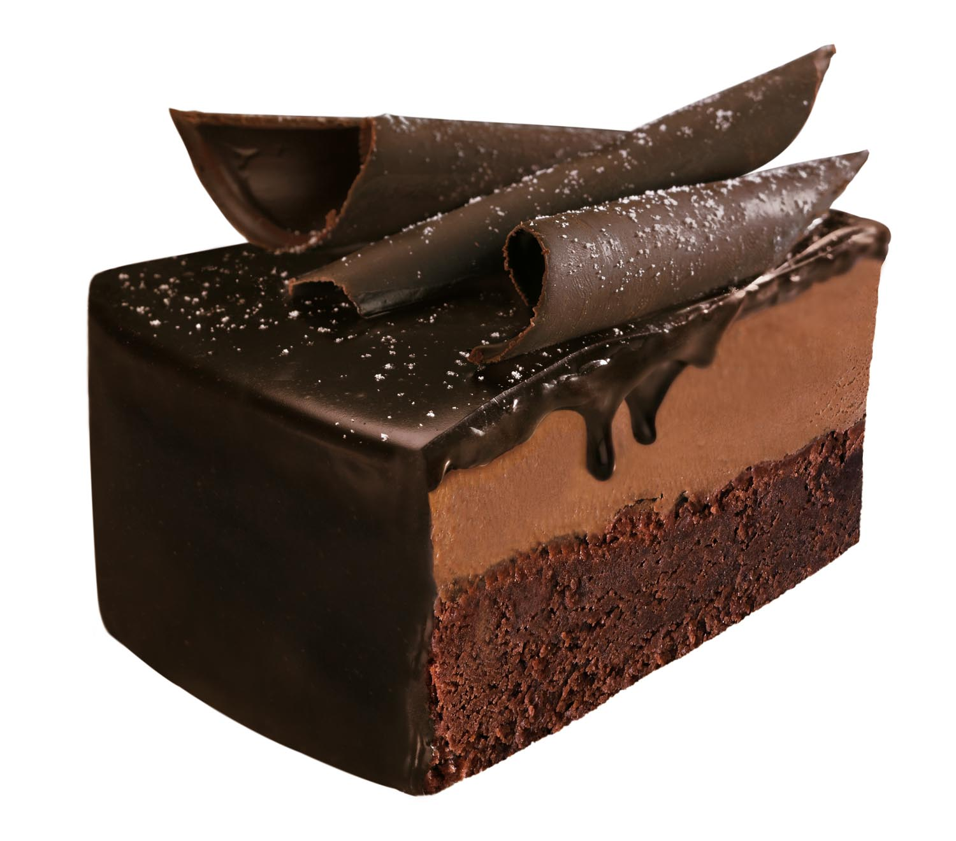
On Saturday he ate through one piece of
chocolate cake,

Slide 15
one ice cream cone,

Slide 16
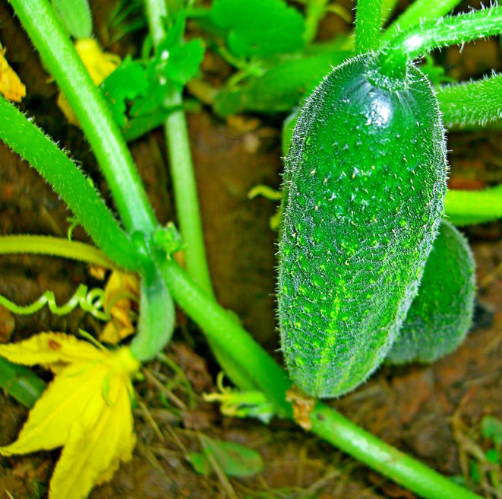
one pickle,

Slide 17
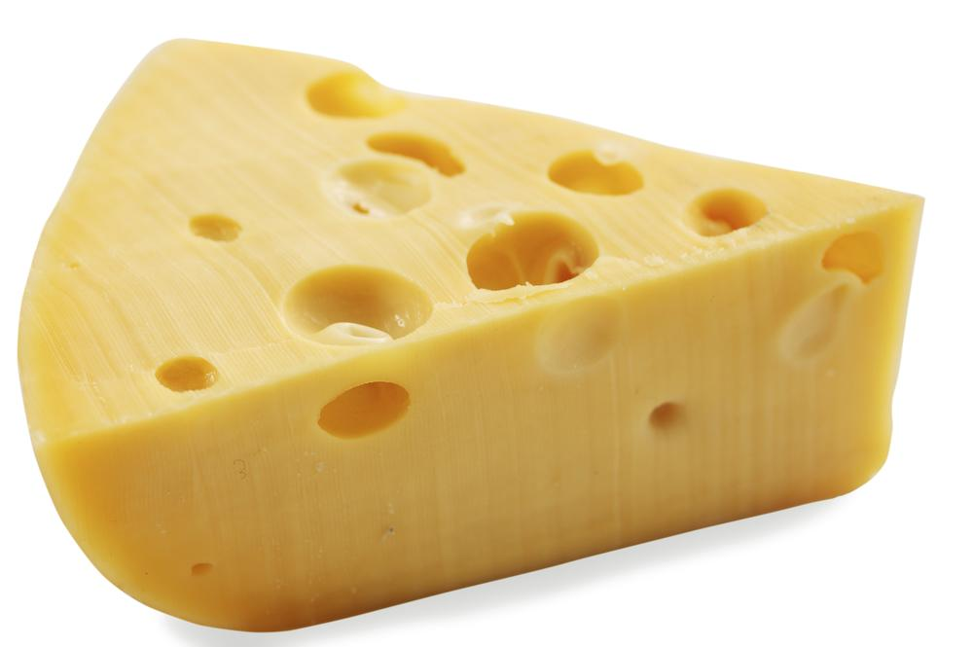
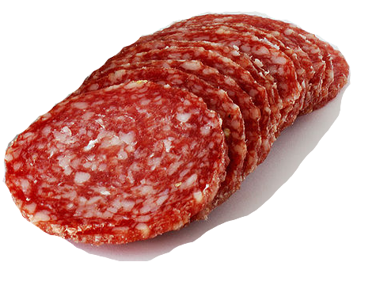
one slice of Swiss cheese,
one slice of salami,

Slide 18
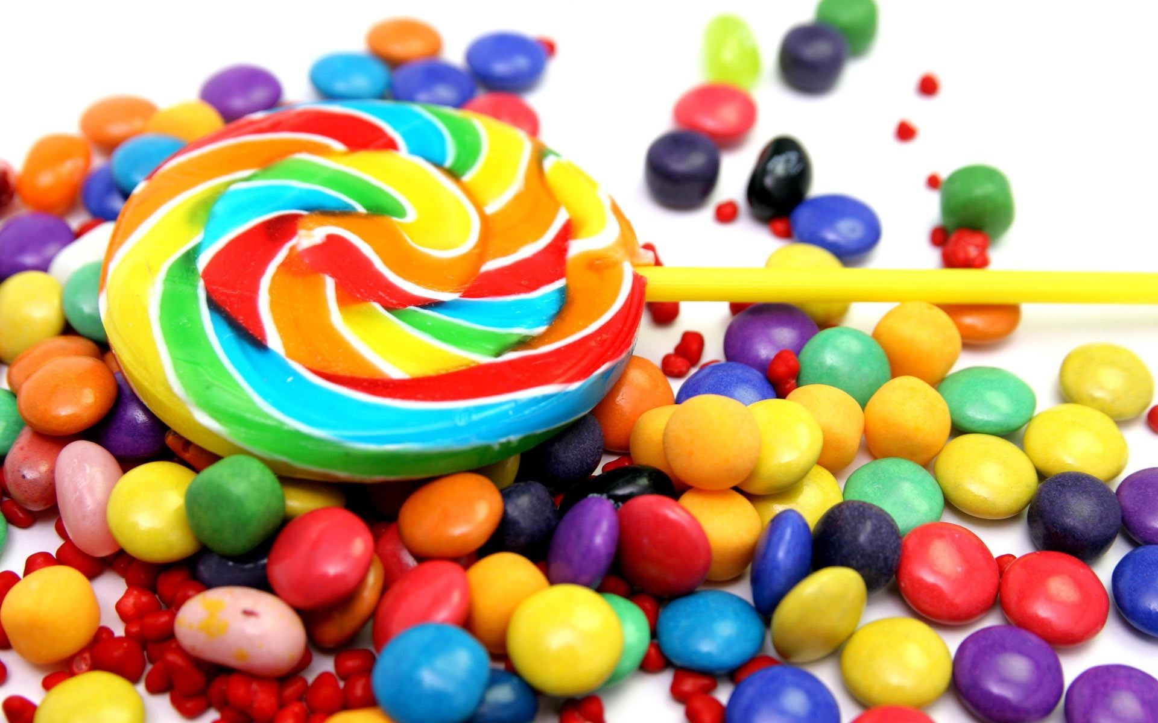
one lollipop,

Slide 19
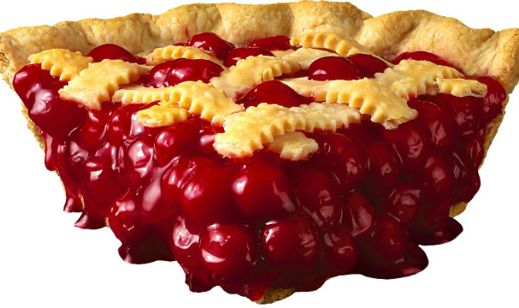
one piece of cherry pie,

Slide 20
one sausage,

Slide 21
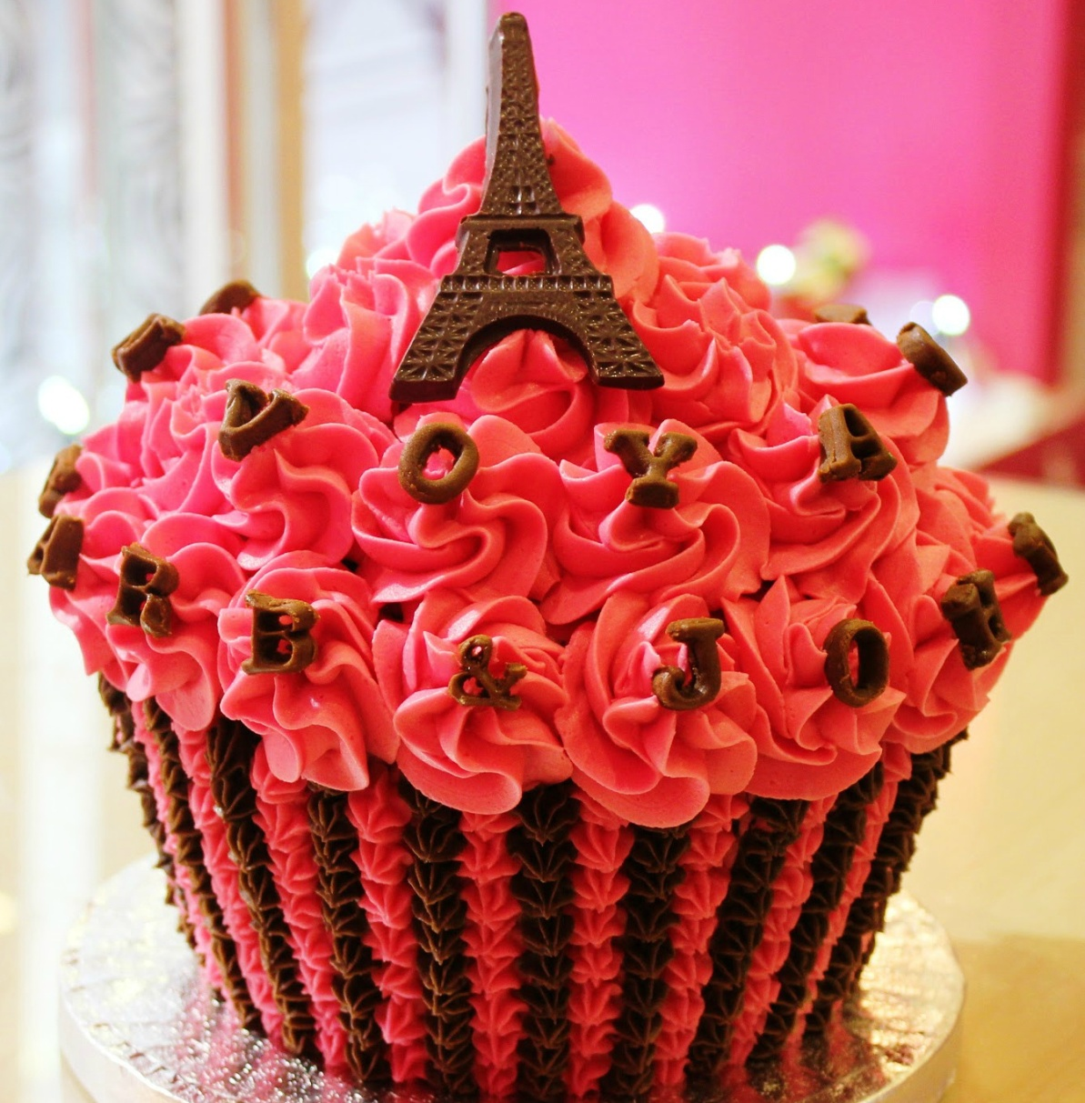
one cupcake,

Slide 22
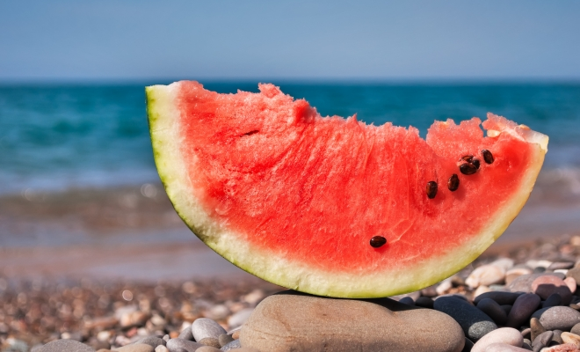
and one slice of watermelon.

Slide 23
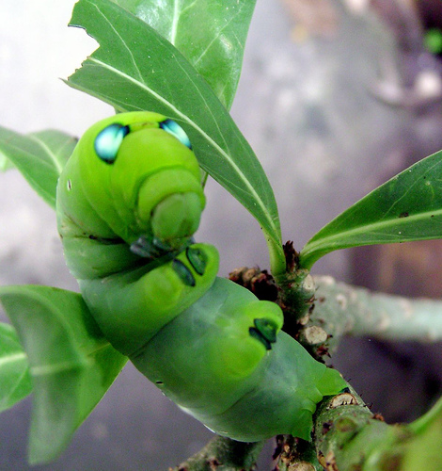
That night he had a stomachache!

Slide 24
The next day was Sunday again.
The Caterpillar ate through one nice green leaf and
after that he felt much better.

Slide 25
Now he wasn’t hungry any more – and he wasn’t little Caterpillar any more.
He was a big, fat Caterpillar.

Slide 26
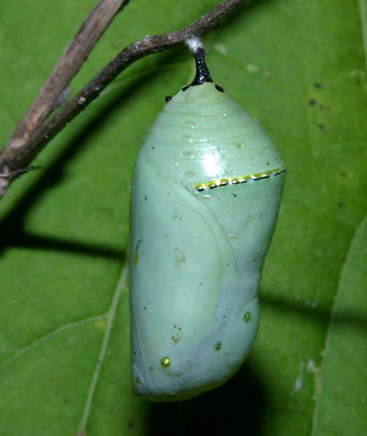
He built a small house, called a cocoon around himself.
He stayed inside for more than two weeks.

Slide 27
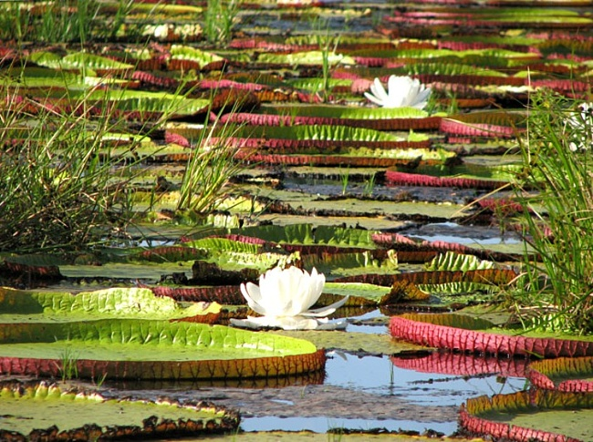

Slide 28
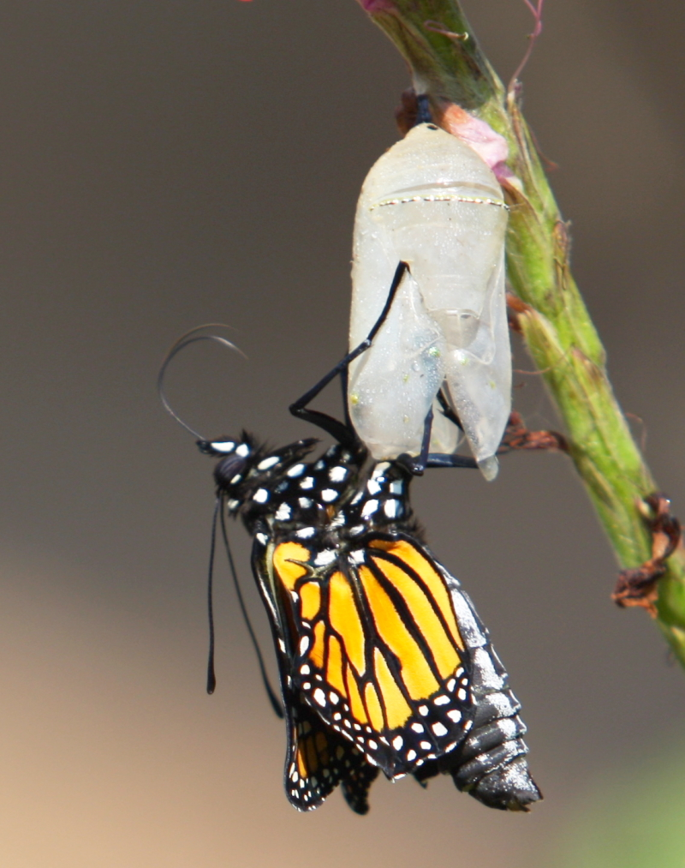
Then he nibbled a hole in the cocoon, pushed
his way out and…..

Slide 29
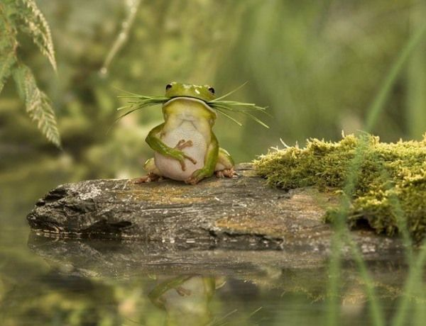

Slide 30
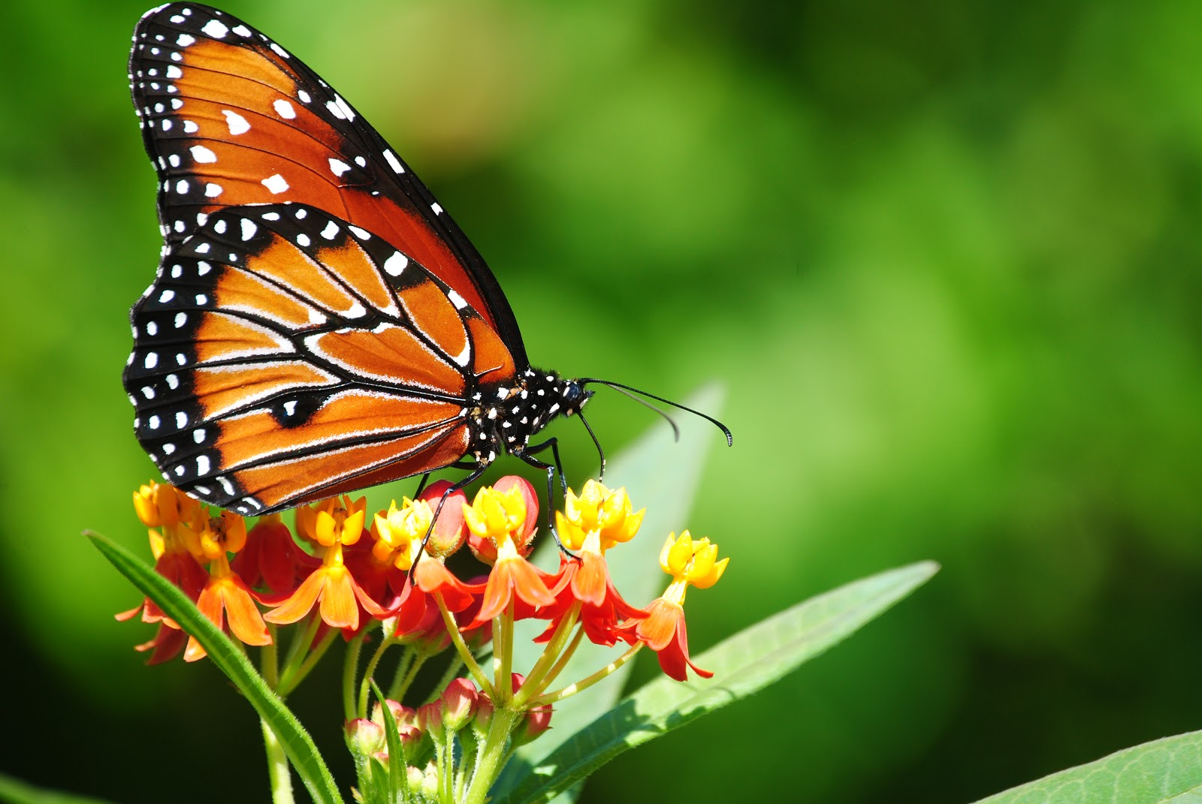
he was a beautiful butterfly!

Slide 31
The End)*******************

